Slide 1
High-Med-Low Dist by Customer / Product
Quanti Consulting
Christopher Brossman

Slide 2
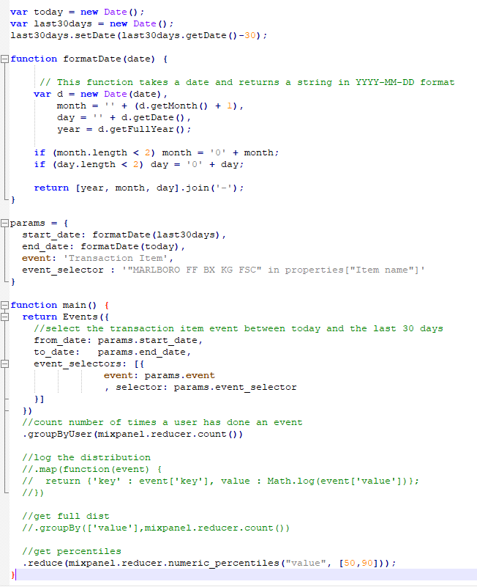
Javascript to attach params to products
What it does
Grabs last 30 days dates for query
Filters for particular event (transactions) & category (Item name & category value (MALBORO FF BX KG FSC)
Counts number of times each user has purchased this category item
Returns params at 50th percentile and 90th percentile

Slide 3
Why 50th and 90th percentile?
Heavily skewed distribution – from 0-50% most users are single purchasers across many different categories and products
To see variability we need to hit 90th percentile – after this rates shoot up drastically – again highly skewed
Logic
If < 50th percentile then low_<product cat>
If > 50th percentile and < 90th percentile then medium_<product cat>
Else high_<product cat>

Slide 4
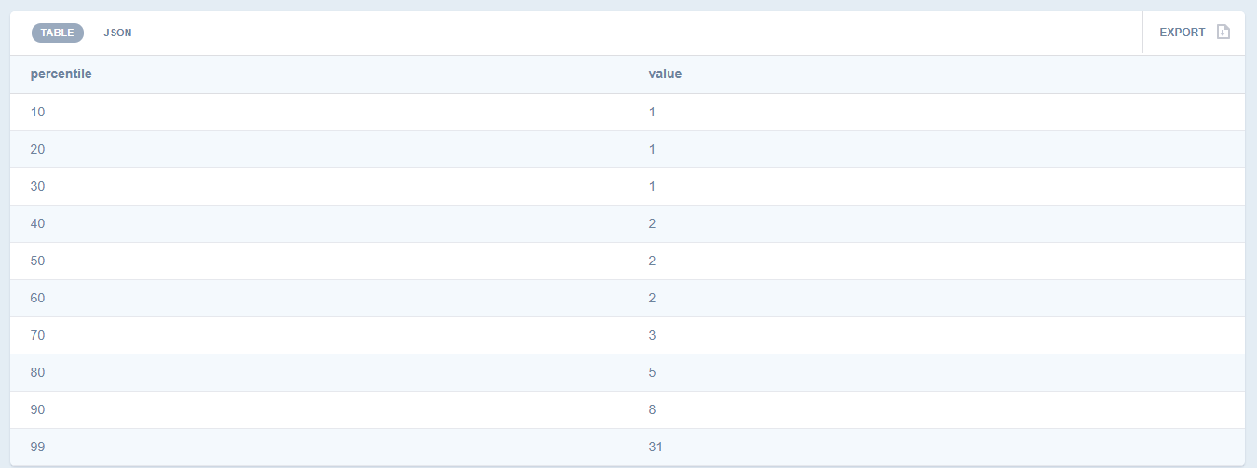
Why 50th and 90th percentile (generic brands in item manufacturer)

Slide 5
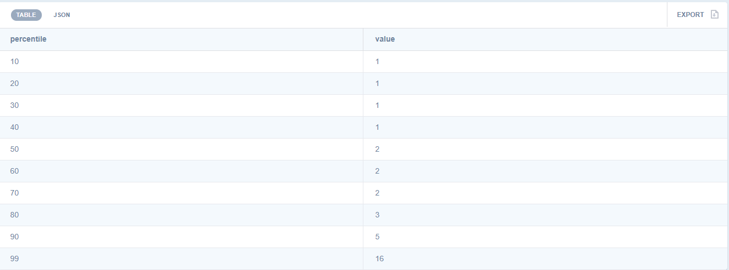
Why 50th and 90th percentile (candy in category name)

Slide 6
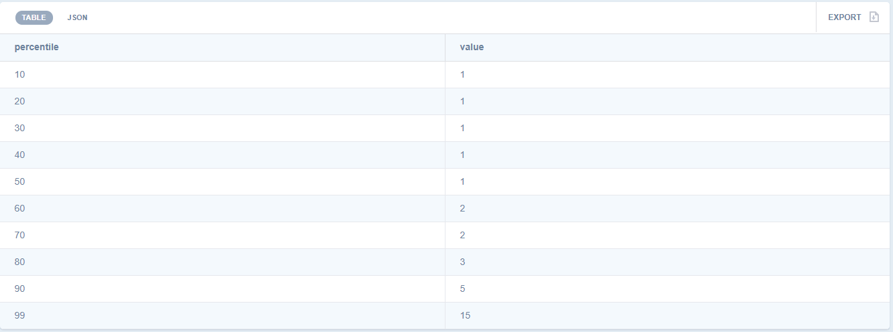
Why 50th and 90th percentile (salty snacks)

Slide 7
Architecture
Two Steps
Assign params to each product monthly
Assign 50th and 90th percentiles on first of month attached to every product
Category Name - Sub category name - item Manufacturer - item Brand – Item name in the Transaction Item event
Time window is last 30 day
These params give indications of cut offs in “low-medium-high” purchases across all customers
JS example attached
Need to implement this first and stored in a list for every product before updating customer list daily
Update customer list daily
Time window is last 30 days
Customer’s last 30 days of sales for every product category are compared to the params on the product to determine “low”, “medium”, “high”
Example – customer X has purchased salty snacks 3 times in the past 30 days and the paramas on salty snacks are [1,5], based on the logic they would be “Salty snacks_medium”
JS to be developed
Need to be a list attached to every customer based on their personal purchase history
Benefits
Allows customer to quickly change rankings per product categories daily

Slide 8
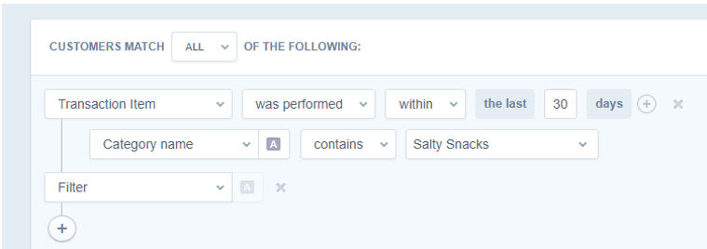
Why Two Steps
Doesn’t seem a way to compare the `count(number of transactions where product category = x)` > `product_cat.params` to assign logic

